Slide 1

Decoding Success: Digital Marketing Internship Project
Mr. Shree Chintamani Sapre
Internship Duration :- January 2024 - February 2024

Slide 2
Introduction :-
Objective: To gain practical experience in digital marketing through a virtual internship at Decoder Bot.
Goals:
Enhance Blog Writing Skills: Sharpened my blog writing skills to create engaging and informative content.
Master Content Creation: Developed proficiency in crafting compelling content for diverse digital platforms.
Effective Social Media Integration: Successfully transformed blog content into impactful social media posts, maximizing online presence.
Master Keyword Research: Gained expertise in keyword research to optimize content for search engines.

Slide 3
Agenda :-
1.Blog Writing Mastery
Overview of blog writing tasks.
Showcase of blog posts.
Key learnings and improvements.
2.Crafting Compelling Content
Overview of content writing responsibilities.
Samples of your content.
Strategies for creating engaging content.

Slide 4
Agenda :-
3.Social Media Integration
Turning Blog Posts into Social Media Posts.
Examples of transformed content.
Social media engagement metrics.
4.Keyword Research Expertise
Importance of keywords in digital marketing.
Your keyword research process.
Notable findings and outcomes.

Slide 5
Section 1: Blogging

Slide 6
Importance of Blogging :-
Blogging is a versatile strategy for businesses to connect with their audience online. Creating regular and high-quality blog content not only establishes a brand as an industry expert but also improves its visibility on search engines by using specific keywords. This dual benefit helps build brand authority and enhance search engine rankings.
Blogs provide a personal way to engage with the audience by delivering valuable, informative, or entertaining content that builds trust and loyalty. The content's versatility extends to social media, allowing businesses to share it in various formats, such as snippets, graphics, or videos, reaching a broader audience.
Blogs also serve as effective tools for lead generation. Well-crafted content, offering valuable insights, acts as a magnet, capturing potential customers through email subscriptions and other engagements.
Moreover, blogs educate customers about products, services, industry trends, and relevant topics, contributing to informed decision-making. Acting as a central content hub, blogs showcase a business's expertise through various content types like videos and infographics, establishing credibility.
Interaction through comments and social media shares fosters customer relationships, creating a personalized experience. Strategically, blogs subtly promote products or services by integrating promotional content within valuable information, striking a balance between information and promotion.
Blogging platforms provide analytics tools to measure performance metrics like page views and conversion rates, guiding businesses in refining their digital marketing strategies for optimal results.

Slide 7
Overview :-
1. Open AI's Growth and Creativity:
- Open AI is a driving force in the ever-evolving field of AI, marked by continuous growth and creativity since its establishment in December 2015.
2. Dedication to AI Research:
- Open AI is dedicated to advancing AI research and has created 4,444 cutting-edge models, emphasizing a community-based approach.
3. GPT-3's Astounding Capabilities:
- GPT-3, with a staggering 175 billion parameters, is a groundbreaking model in the Generative Pretrained Transformer (GPT) series, revolutionizing natural language processing.

Slide 8
4. Versatility of GPT-3:
- GPT-3 goes beyond boundaries, finding applications in generating code, content creation, and providing sophisticated answers. Its adaptability has changed the landscape of natural language processing.
5. Applications in Content Creation and Automation:
- GPT-3 has practical applications in content creation, chatbots, and creative writing, in addition to coding. It understands context well, making it valuable for businesses focusing on client relations and automated content generation.
6. Open AI's Ethical Commitment:
- Open AI is dedicated to safety and moral AI, adopting a cooperative strategy to address potential risks associated with sophisticated AI systems.
7. Bias Elimination and Equity Focus:
- Open AI is actively working to eliminate biases in its models, taking 4,444 steps to ensure equity. It prioritizes representative and diverse training data for impartial and fair AI systems

Slide 9
8. Practical Applications in Shifting Sectors:
- Open AI's models are used in various sectors for automation and content creation, freeing up human resources to focus on strategic and creative aspects of their jobs.
9. Revolutionizing Education:
- Open AI models are transforming education with personalized learning experiences, automated grading systems, and interactive learning materials.
10. Articles for Deeper Insights:
- Explore articles offering a deeper understanding of Open AI's influence, covering GPT-3's architecture, ethical considerations, and real-world industry applications.
11. Charting the Future of AI:
- Open AI is shaping the future of artificial intelligence through groundbreaking research, ethical considerations, and practical applications across diverse industries. It builds the groundwork for a responsible and advantageous future for humanity, emphasizing security, ethics, and cooperation.

Slide 10
Section 2: Content Writing

Slide 11
Crafting Compelling Content
Audience-Centric Approach:
Highlight: Prioritize understanding your target audience's needs, interests, and preferences. Tailor your content to address their specific challenges or provide valuable information that resonates with them.
Compelling Headlines and Openers:
Highlight: Craft attention-grabbing headlines and opening lines. These elements serve as the first impression and determine whether the audience will continue reading. Make them compelling, clear, and intriguing.
Visual Appeal:
Highlight: Incorporate visually appealing elements such as images, infographics, and videos. Visual content not only breaks up text but also enhances overall engagement and shareability.
Consistent Brand Voice:
Highlight: Maintain a consistent brand voice across your content. Consistency builds familiarity, trust, and a strong brand identity. Ensure that your tone aligns with your brand values and resonates with your audience.
Storytelling Techniques:
Highlight: Use storytelling to create an emotional connection with your audience. Narratives make content more relatable and memorable. Share stories that evoke emotions and convey your message effectively.
Interactive Elements:
Highlight: Integrate interactive elements like polls, quizzes, or surveys to actively involve your audience. Participation fosters engagement and makes the content more dynamic, encouraging users to spend more time with it.

Slide 12
Overview :-
Overview of Human Evolution
The introduction provides a brief overview of humanity's long history, emphasizing significant changes from the Stone Age to modern times.
Stone Age Evolution: Paleolithic, Mesolithic, and Neolithic Eras
The Stone Age is divided into three periods: Paleolithic, Mesolithic, and Neolithic, showcasing the progression from simple tools to the development of farming and civilization.
Challenges of the Ice Age and Adaptations
Describes the hardships of the Ice Age, highlighting how humans adapted by becoming nomadic, mastering clothing and shelter creation, and learning to use fire for survival.
Agricultural Revolution and Societal Shifts
Discusses the Agricultural Revolution around 10,000 BCE, a pivotal moment where humans shifted from nomadic lifestyles to settled farming, leading to the formation of villages, towns, and complex societies.

Slide 13
Modern Era: Industrial Revolution and Global Connectivity
Jumps to the modern era, emphasizing the transformative impact of the Industrial Revolution, technological advancements, and global connectivity on contemporary living.
Challenges of Modernity: Environmental Concerns and Climate Change
Acknowledges the conveniences of modern life while addressing the challenges, particularly the need to address environmental issues and climate change resulting from contemporary living.
Reflecting on Human Adaptability and Future Goals
The conclusion emphasizes the adaptability of humans throughout history, encourages learning from the past, and advocates for a future where humanity lives harmoniously with the world, acknowledging the challenges faced in the present era.

Slide 14
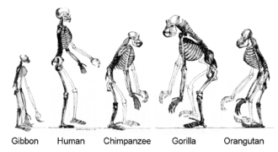

Human evolution

Slide 15
Section 3: Social Media

Slide 16
Transforming Blog Content :-
Content Selection:
dentify key points or highlights from your blog content that are suitable for social media. Focus on information that is engaging, informative, or share-worthy.
Craft Engaging Headlines:
Create attention-grabbing headlines that encapsulate the essence of your blog content. Keep them concise and compelling to encourage clicks and engagement.
Visual Content Creation:
Develop visually appealing content such as images, infographics, or quote graphics that complement the selected blog content. Visuals enhance shareability and attract attention on social media.
Condense and Summarize:
Condense the information from your blog into shorter, digestible snippets. Summarize key points to make the content more accessible and suitable for social media consumption.

Slide 17
Tailor for Each Platform:
Customize your posts for different social media platforms, considering character limits, image dimensions, and the preferred style of content for each platform (e.g., Instagram, Twitter, LinkedIn).
Use Hashtags Strategically:
Incorporate relevant hashtags to increase the discoverability of your social media posts. Research popular and niche hashtags related to your content and industry.
Encourage Engagement:
Craft captions that encourage audience engagement. Pose questions, invite comments, or create polls related to your blog content. Foster a sense of community and interaction around your posts.

Slide 18
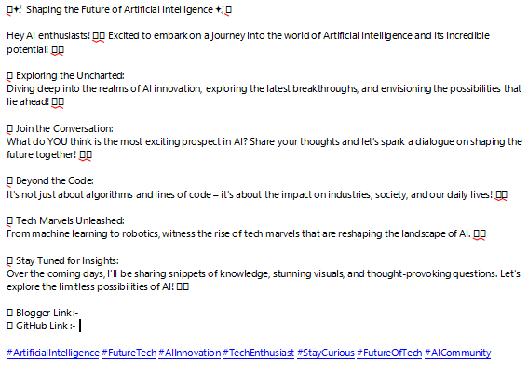
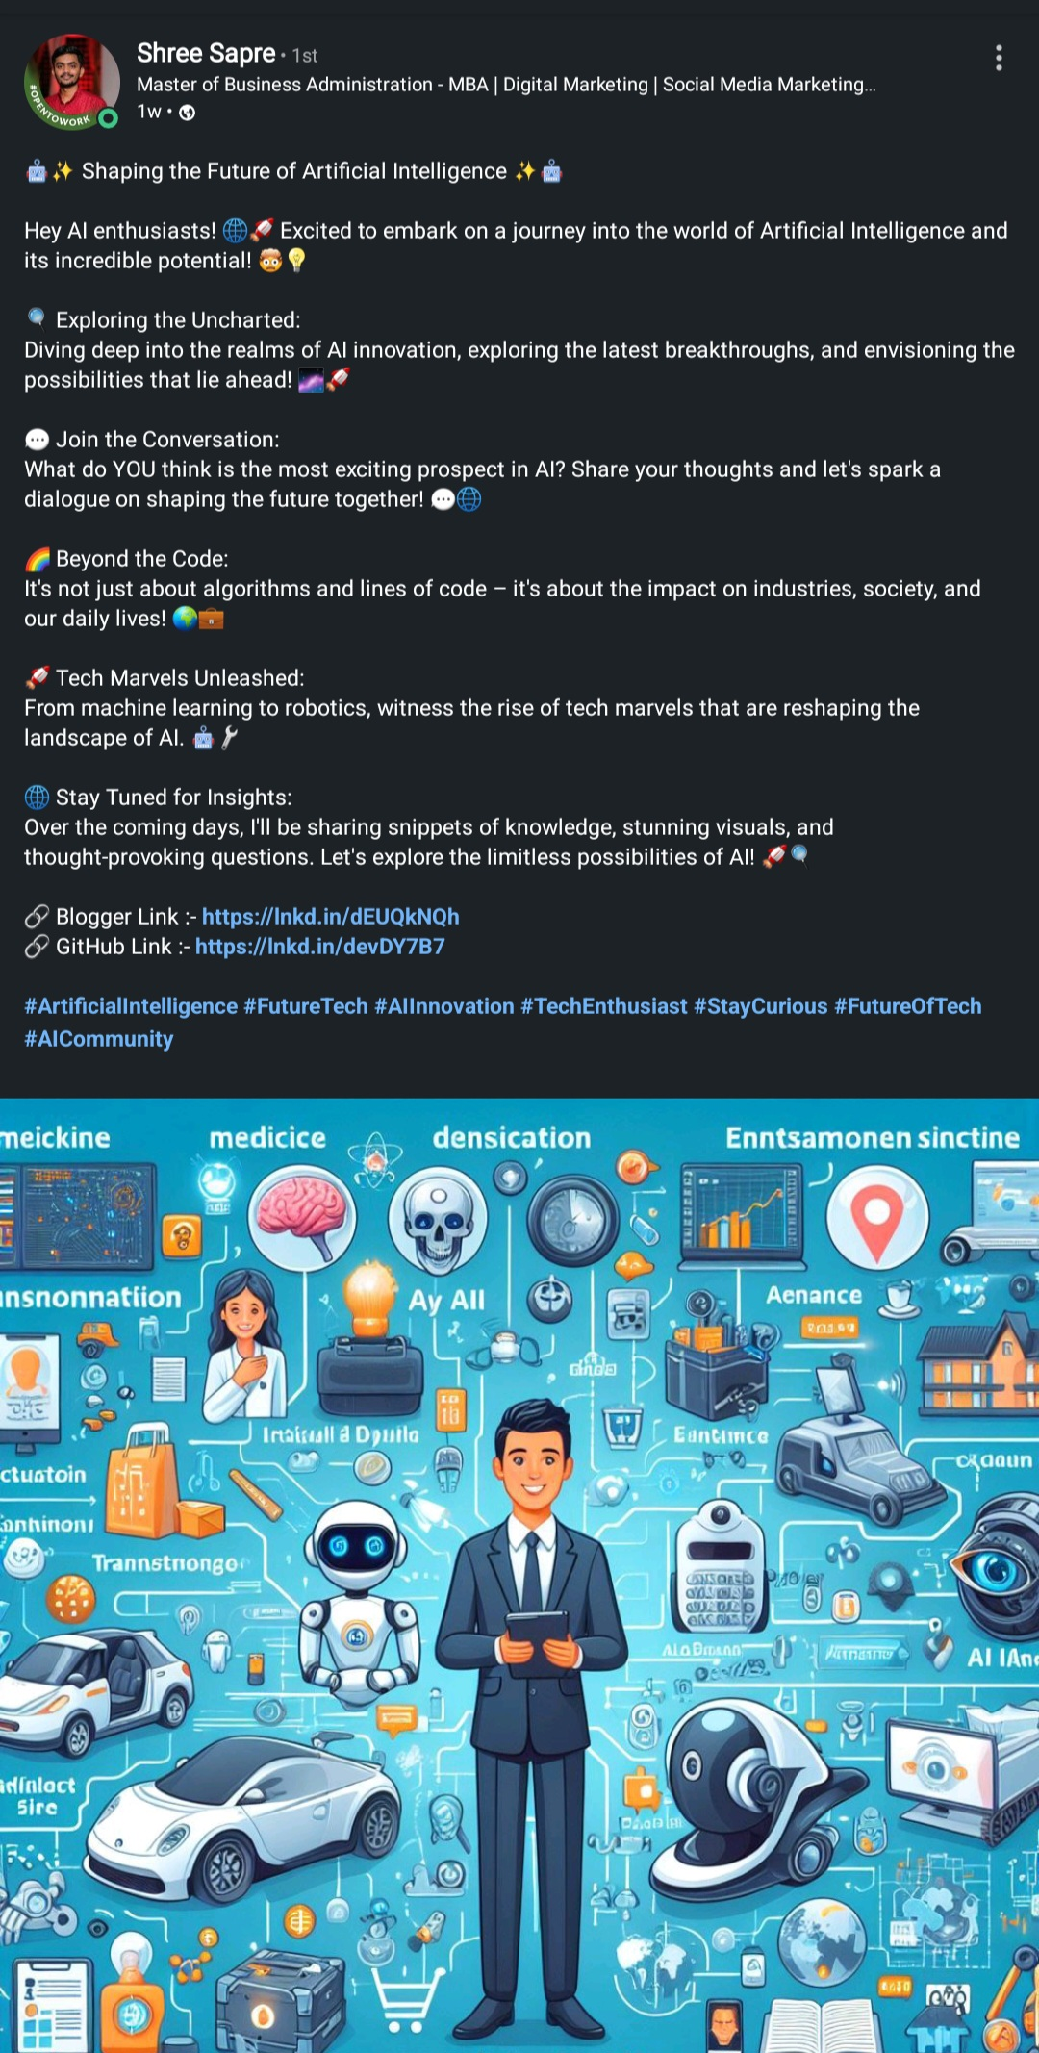
Before & After

Slide 19
Section 4: Keyword Research

Slide 20
Importance of Keywords Research
Search Engine Optimization (SEO) is about making a website show up higher in search results. Keywords are like the key words or terms that people type into search engines. These are crucial because search engines use special formulas to figure out if a webpage is a good match for what someone is looking for. So, by cleverly using the right words in website content, tags, and other parts, marketers can make a website more likely to appear when someone searches for something.
Paid Advertising (PPC): In paid ads, businesses bid on specific words to show their ads when people search for those words. Picking the right words ensures that the ads are seen by the right people, making it more likely to get potential customers. This not only helps in showing ads to the right audience but also in spending money on ads more wisely.
Content Creation and Marketing: Keywords help in creating content that people are interested in. This content, like blog posts, articles, videos, or pictures, can attract visitors to a website. It also helps in showing that a brand knows a lot about its industry.
User Intent and Relevance: Understanding what people are looking for when they search is crucial. By using the right words, marketers can make sure that what they offer matches what people want. This not only helps in getting the right visitors but also in turning them into customers.
Competitive Analysis: Looking at the words that competitors use is important. By knowing what words work well for others, businesses can decide which words to use to stand out and stay competitive.
Measuring and Analyzing Performance: Keywords help in figuring out how well a website is doing. Tools like Google Analytics show which words bring in visitors, keep them engaged, and make them take actions like buying something. This information helps in making the website better over time.

Slide 21
Keyword Research Process
Define Objectives:
Clearly outline the goals of your keyword research. Identify whether it's for SEO, PPC campaigns, content creation, or a combination of these.
Identify Seed Keywords:
Start with a list of broad and general keywords related to your business or industry. These are the initial terms from which you'll expand your research.
Use Keyword Research Tools:
Employ tools like Google Keyword Planner, SEMrush, or Ahrefs to discover related keywords. Pay attention to search volume, competition, and relevance.
Consider User Intent:
Understand the intent behind user searches. Determine whether users are looking for information, products, or specific services. Tailor your keyword selection to match this intent.
Evaluate and Prioritize:
Assess the search volume and competition for each keyword. Strike a balance between high-volume keywords and those with lower competition. Prioritize keywords based on relevance to your goals.
Create a Keyword Strategy:
Develop a cohesive keyword strategy that aligns with your overall marketing objectives. Organize keywords into themes or topics, guiding your content creation, on-page optimization, and paid advertising efforts.

Slide 22
Significant Findings
Relevant Traffic Increase:
By identifying and targeting highly relevant keywords, you can attract traffic that is more likely to engage with your content or convert into customers. This can lead to a significant increase in the quality of traffic to your website.
Improved Search Engine Rankings:
Strategically incorporating relevant keywords into your website's content and meta tags can enhance its visibility in search engine results pages. This, in turn, may lead to improved rankings, making your website more easily discoverable by users.
Optimized Paid Advertising Campaigns:
Effective keyword research is crucial for PPC advertising. Choosing the right keywords ensures that your ads are shown to a relevant audience, improving the chances of attracting potential customers and optimizing your advertising budget.
Content Relevance and Authority:
Keyword research guides content creation by identifying the topics and terms your target audience is searching for. Creating high-quality, keyword-rich content helps establish your brand as an authority in its industry and attracts organic traffic.
Enhanced User Experience:
Understanding user intent through keyword research allows you to align your content and advertising with what users are actively searching for. This not only improves the user experience but also increases the likelihood of conversions as your offerings directly meet user needs.
Competitive Advantage:
Analyzing keywords used by competitors provides valuable insights. By identifying keywords that competitors are successfully targeting, you can refine your own strategy, uncover new opportunities, and maintain a competitive edge in the market.

Slide 23
Section 5: Conclusion

Slide 24
Key Learnings :-
Hands-On Experience in Keyword Research:
Your internship provided practical experience in conducting keyword research. This involved identifying, analyzing, and strategically implementing keywords to enhance online visibility and optimize content for search engines.
Content Creation and Blog Writing Skills:
The internship allowed you to develop and showcase your content creation skills. Writing blogs and creating content demonstrated your ability to produce engaging and relevant material for digital marketing purposes.
Application of SEO Strategies:
You gained insights into Search Engine Optimization (SEO) strategies by incorporating keywords into website content, meta tags, and other elements. This hands-on experience likely contributed to improving search engine rankings and driving organic traffic.
Practical Understanding of User Intent:
Through keyword research and content creation, you developed a practical understanding of user intent. Aligning content and keywords with what users are actively searching for helps enhance the user experience and increase the likelihood of conversions.
Optimizing Paid Advertising Campaigns:
Your internship involved working on paid advertising tasks, where you bid on specific keywords for PPC campaigns. This experience likely honed your skills in choosing the right keywords to target a relevant audience, thereby maximizing ad visibility and managing advertising budgets efficiently.
Competitive Analysis and Strategy Refinement:
Analyzing keywords used by competitors was a significant aspect of your internship. This competitive analysis allowed you to refine your own keyword strategy, identify potential opportunities, and maintain a competitive edge in the digital marketing landscape.

Slide 25
Challenges and Solutions
1.Keyword Research Complexity:
Challenge: Understanding and navigating the complexities of keyword research, including selecting the right keywords and analyzing their effectiveness.
Overcoming Strategy: Engage in comprehensive training and research on keyword research tools. Seek guidance from mentors or team members with expertise in SEO to better understand the nuances of keyword analysis.
2.Content Creation Demands:
Challenge: Balancing the demands of creating engaging and relevant content consistently.
Overcoming Strategy: Develop a content calendar to plan and organize your content creation efforts. Break down larger tasks into smaller, manageable steps and prioritize based on deadlines and importance.
3.Staying Updated with SEO Trends:
Challenge: Keeping up with the ever-evolving landscape of SEO and staying informed about algorithm changes and industry trends.
Overcoming Strategy: Dedicate time for continuous learning. Subscribe to industry newsletters, blogs, and forums to stay updated. Attend webinars or training sessions to enhance your knowledge of SEO best practices.
4.Balancing SEO and User Intent:
Challenge: Ensuring that SEO efforts align with user intent and provide a positive user experience.
Overcoming Strategy: Conduct thorough user intent research alongside keyword research. Focus on creating content that addresses user needs, making it both search engine-friendly and valuable to your audience.
5.Handling Competitor Analysis:
Challenge: Analyzing competitor keywords and strategies can be time-consuming and complex.
Overcoming Strategy: Break down competitor analysis into manageable steps. Utilize competitor analysis tools, collaborate with team members for insights, and prioritize key competitors to study in-depth.

Slide 26
Future Recommendations
Strategic Blog Series:
Develop a strategic blog series that deep-dives into specific topics related to your industry or niche. Plan a series of interconnected posts that not only showcase your expertise but also provide comprehensive and valuable information for your audience.
Visual Content Campaign:
Launch a visual content campaign by creating visually appealing and shareable content. Consider developing infographics, videos, or interactive content that not only communicates key messages effectively but also resonates with your target audience visually.
Seasonal Content Calendar:
Create a seasonal content calendar to align your content with specific events, holidays, or industry trends throughout the year. This approach allows you to stay relevant, capture seasonal search traffic, and engage with your audience based on timely topics.
User-Generated Content Initiative:
Implement a user-generated content initiative where you encourage your audience to create and share content related to your brand or products. This not only fosters community engagement but also provides authentic and diverse content for your digital marketing efforts.
Multichannel Advertising Campaign:
Design a multichannel advertising campaign that spans different platforms. Utilize a mix of paid advertising on platforms like Google Ads and social media channels to reach a broader audience. Ensure consistency in messaging across channels while tailoring content to each platform's unique characteristics.

Slide 27
Thank You
I want to extend my sincere gratitude to my exceptional team, mentors, and all those who supported me throughout this internship. Your unwavering guidance, encouragement, and collaborative spirit have played a crucial role in my professional development. Working alongside such dedicated individuals has been both inspiring and rewarding. I appreciate the knowledge shared, the challenges overcome together, and the positive impact this experience has had on my growth.
Thank you all for being an integral part of my journey during this internship.

Slide 28


Contact Information :-
:> https://www.linkedin.com/in/shree-sapre-067057272/
:> shreesapre08@gmail.com

